Slide 1
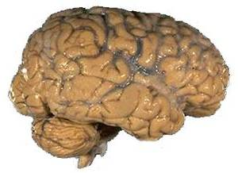
The nervous system

Slide 2

The nervous system
Main Function:
This communication system controls and coordinates functions throughout the body and responds to internal and external stimuli.
Our nervous system allows us to feel pain
☹

Slide 3
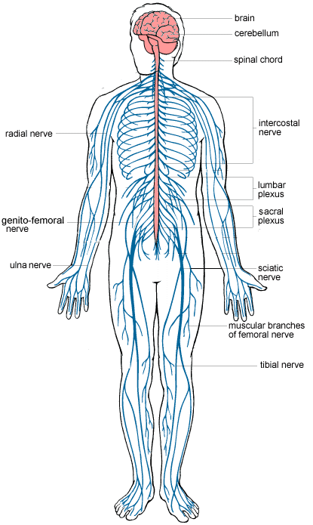
Nervous system
It consists of 2 parts:
The central nervous system (CNS) consists of the brain, spinal cord.
The peripheral nervous system contain the other nerves and receptors of our body.

Slide 4
The Central Nervous System
Cerebrum | Voluntary or conscious activities of the body-learning, judgment
Cerebellum | Coordinates and balances the actions of the muscles
Medulla Oblongata (Brain Stem) | Controls involuntary actions like blood pressure, heart rate, breathing, and swallowing
Spinal Cord | The main communications link between the brain and the rest of the body

Slide 5
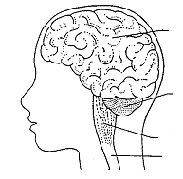
The CNS
Consists of: Brain, Cerebrum, Cerebellum, Brain stem, Spinal Cord
Cerebrum
Brain
Cerebellum
Medulla Oblongata
Spinal Cord

Slide 6
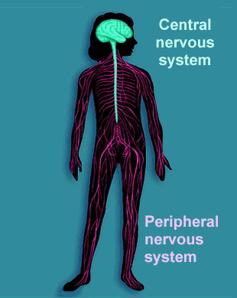
The Peripheral Nervous System
Consists of: Sensory division and Motor division
-Includes all sensory neurons, motor neurons, and sense organs

Slide 7
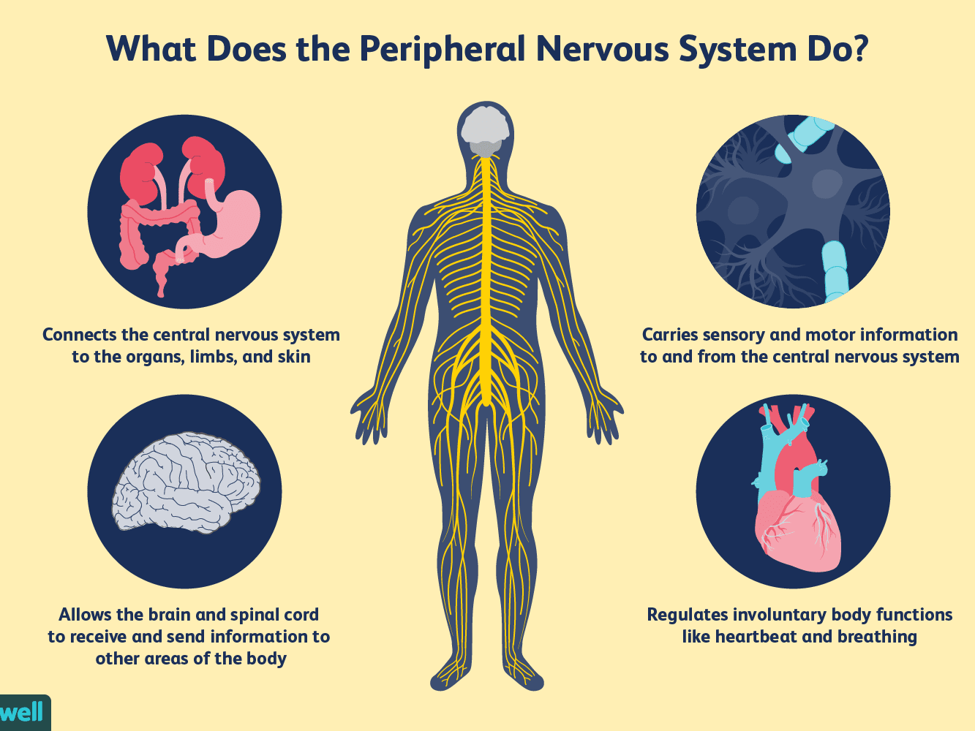
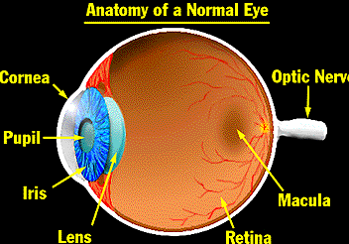
PNS Consists of: Brain, Spinal cord, Nerves and Sense organs
Sense Organs: Eyes, Skin, Ears, Nose & Tongue

Slide 8
Our senses
Cells called receptors detect stimuli (changes) in our environment.
Our receptors can be found:
Eyes – sensitive to light
Ears – sensitive to sound
Nose – sensitive to smell
Skin – sensitive to touch, pressure, and temperature
Mouth – sensitive to chemicals in food.

Slide 9
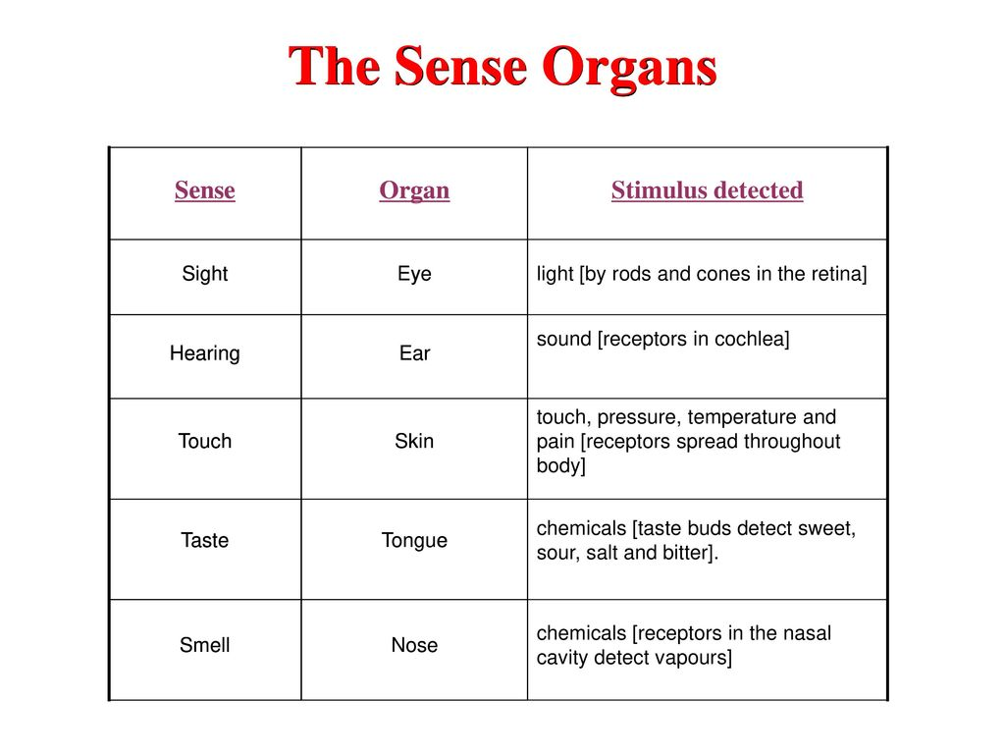

Slide 10
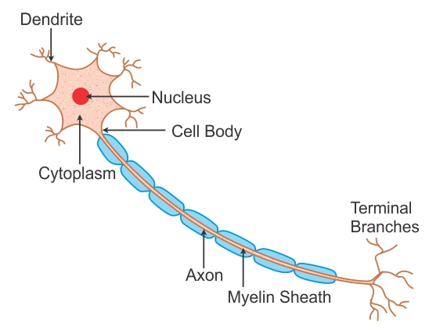
How is information transmitted?
Information passes from receptors along cells called neurones.
A neurone is a nerve cell
Nerve cells are long and thin to carry messages called impulses.

Slide 11
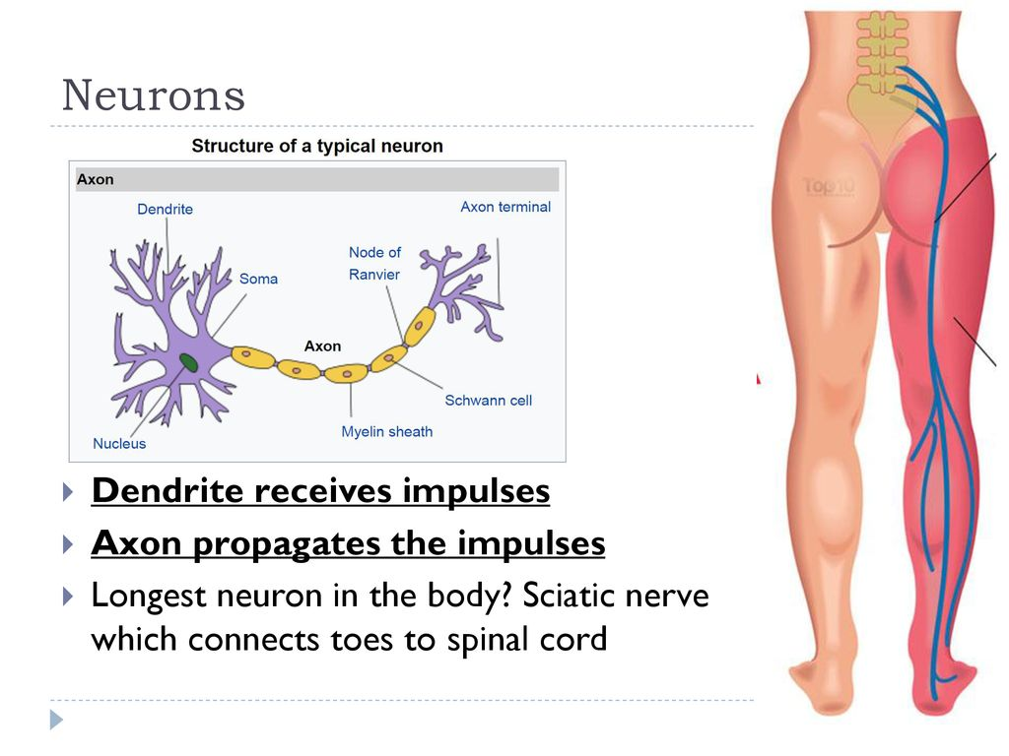

Slide 12
There are 3 types of neurons:
Sensory neurone – carry impulse from receptor to CNS
Relay – connects sensory to motor
Motor – connects CNS to effector which makes a response. (muscle, gland)

Slide 13
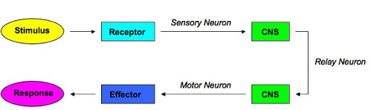
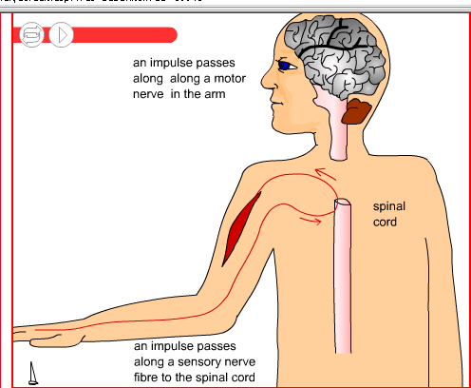
Response to stimuli
Stimulus >> receptor>> sensory >> co –ordinator>> motor >>effector >Response

Slide 14
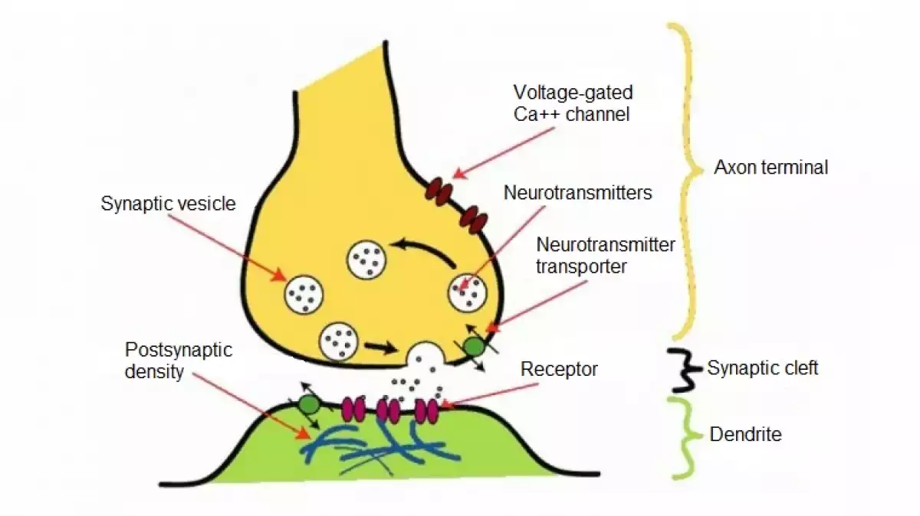
Neurotransmitters
Neurotransmitters
are chemicals that
transmit signals
from a neuron to a
target cell across a
synapse (gap)

Slide 15
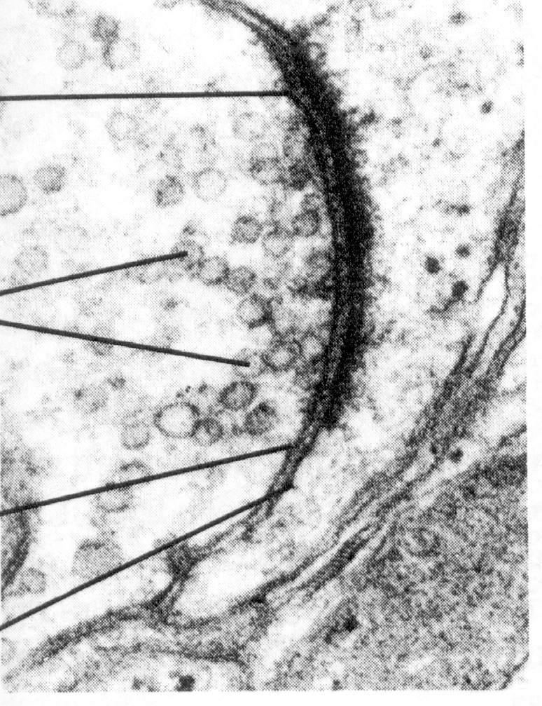
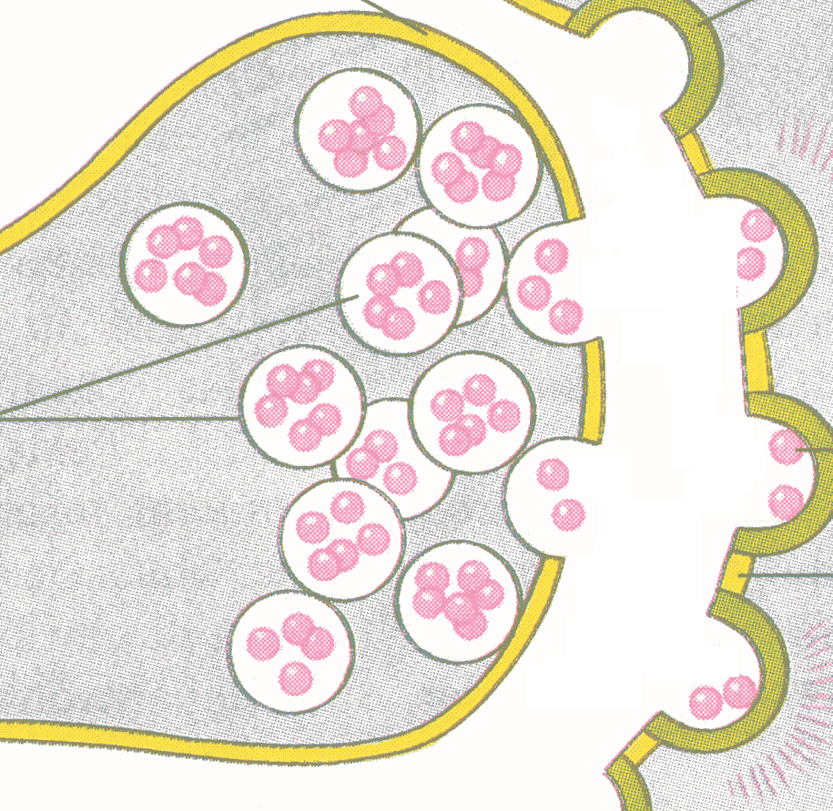

Because neurons never touch, chemical signalers called neurotransmitters must travel through the space called synapse between two neurons.
Neurotransmitters
(pink
spheres)
The message is transferred when RECEPTORS receive neurotrans-mitters.
Synapse (gap)

Slide 16
